Slide 1
B09S0061 Software Engineering
Lecture 6
Instructor: Liu, Guangchi Ph.D.
2025/03/28
Notes:
本模板基于“中国科学院大学-路人丁-PPT模板”魔改而成，著作权归该作者所有。
本模板中使用的东南大学校徽、校标文字组合、校训文字等素材来自于微信公众号“金木屋”。
本模板的视觉设计参考了“东南大学视觉识别系统”。
人物介绍页头像素材来自 小肥柴。
本模板力求简洁，布局合理，主次分明。以学术风为设计理念，适用于学术报告与论文答辩等相关应用场景。模板未使用任何动画效果。
您仅可以以个人非商业用途使用本PPT模板，不可将信息内容的全部或部分用以出售，或以出租、出借、转让、分销、发布等其他任何方式供其他人使用。
欢迎 持续关注东南大学止于至善学术风 PPT 模板 （https://zhuanlan.zhihu.com/p/335298500）后续的功能优化及多语言更新版本。
最后，祝汇报顺利，马到成功！
Version: (2021) v1.5-en.

Slide 2
1
PART ONE
System Design with UML

Slide 3
Design
Design in Software Development
For a given set of requirements, the software development team must design a system that will meet those requirements.
This has many aspects:
• system architecture
• program design
• security
• performance
Design was also an important part of the lectures on usability.
In practice requirements and design are interrelated. In particular, working on the design often clarifies the requirements. This feedback is a strength of the iterative and agile methods of software development.

Slide 4
Creativity and Design
Creativity and design
System and program design are a particularly creative part of software development, as are user interfaces.
Above all strive for simplicity. The aim is find simple ways to implement complex requirements.
You hope that people will describe your designs as “elegant”, “easy to implement, test, and maintain.”
“Beautiful is better than ugly, simple is better than complex”------Zen of Python
Software development as a craft
Software development is a craft. Software developers have a variety of tools that can be used in design, but you have to select the appropriate tool for a given implementation.

Slide 5
System Architecture
System architecture is the overall design of a system:
• Computers and networks (e.g., in-house computers, cloud services)
• Interfaces and protocols (e.g., http, IMAP, ODBC)
• Databases (e.g., relational, distributed)
• Security (e.g., Shibboleth)
• Operations (e.g., backup, archiving, audit trails)
At this stage of the development process, you should also be selecting:
• Software environments (e.g., languages, database systems, class frameworks)
• Testing frameworks

Slide 6
Models for System Architecture
Our models for systems architecture are based on UML.
For every system, there is a choice of models. Choose the models that best model the system and are clearest to everybody.
In UML, every model must have both a diagram and a supporting specification.
The lectures provide diagrams that give an outline of the system, without the supporting specifications.
The diagrams shows the relationships among parts of the system, but much, much more detail is needed to specify a system.
Dilemma: too professional for non-tech guys, too unprofessional for tech guys
Too many symbols and rules to be remembered
No strict syntax/compiler guided
UML Tools: Processon, Visual Paradigm, Visio, etc.

Slide 7
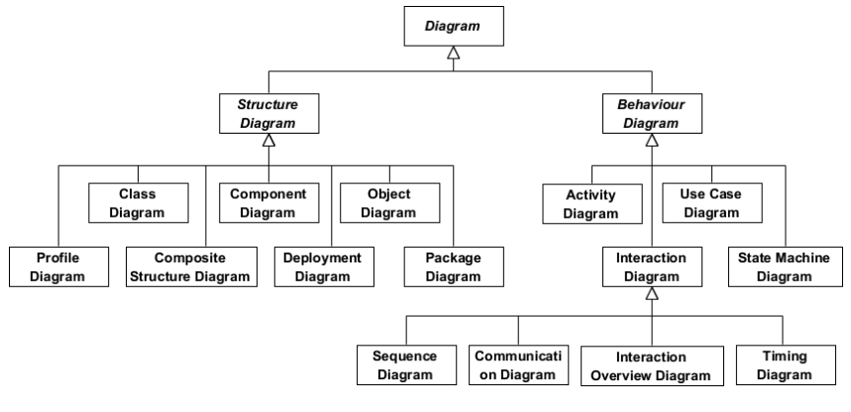
Diagram Categories

Slide 8
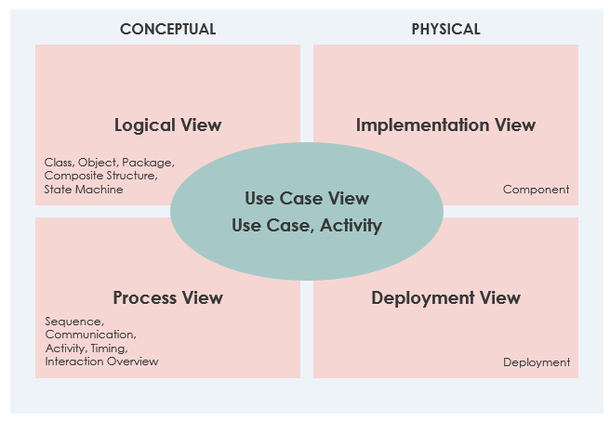
View of Various Diagrams
Use Case View
Logical View
Implementation View
Process View
Deployment View

Slide 9
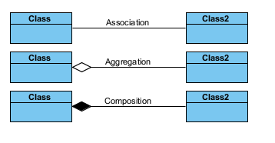
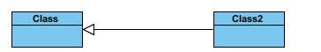
Basic Relations in UML
Generalization
Dependency

Slide 10
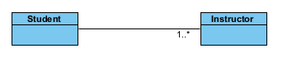
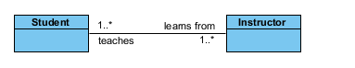
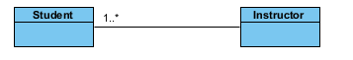
Association

Slide 11
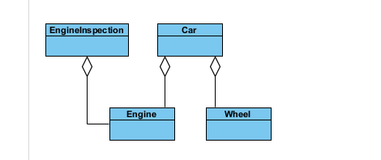
Aggregation

Slide 12
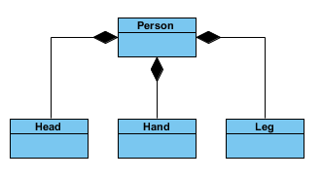
Composition

Slide 13
Comparision
Aggregation and Composition are specific cases of Association
In both aggregation and composition object of one class "owns" object of another class
Aggregation implies a relationship where the child can exist independently of the parent.
Example: Class (parent) and Student (child). Delete the Class and the Students still exist.
Composition implies a relationship where the child cannot exist independent of the parent.
Example: House (parent) and Room (child). Rooms don't exist separate to a House.

Slide 14
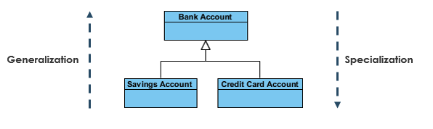
Generalization/Specialization
The UML diagram's Generalization association is also known as Inheritance in a programming language

Slide 15
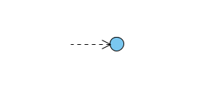
Dependency
A dependency is a relationship that signifies that a single or a set of model elements requires other model elements for their specification or implementation.
This means that the complete semantics of the depending elements is either semantically or structurally dependent on the definition of the supplier element(s).

Slide 16
Subsystems
Subsystem
A subsystem is a grouping of elements that form part of a system.
• Coupling is a measure of the dependencies between two subsystems. If two systems are strongly coupled, it is hard to modify one without modifying the other.
• Cohesion is a measure of dependencies within a subsystem. If a subsystem contains many closely related functions its cohesion is high.
An ideal division of a complex system into subsystems has low coupling between subsystems and high cohesion within subsystems.

Slide 17
Component Diagram
A component is a replaceable part of a system that conforms to and provides the realization of a set of interfaces.
A component can be thought of as an implementation of a subsystem.
UML definition of a component
"A distributable piece of implementation of a system, including software code (source, binary, or executable), but also including business documents, etc., in a human system."

Slide 18
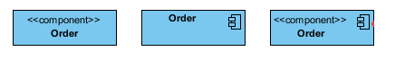
Component Diagram

Slide 19
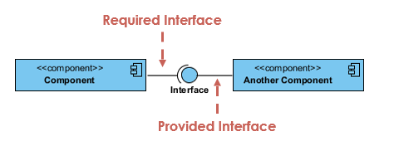
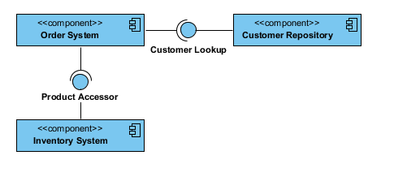
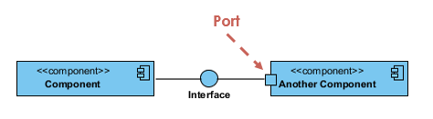
Component Diagram
Provided interface represents an interface that the component provides
Required Interface represents an interface that the component requires
Port is often used to help expose required and provided interfaces of a component

Slide 20
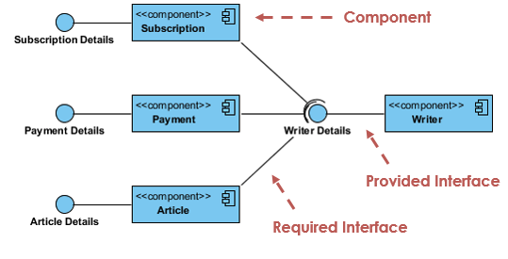
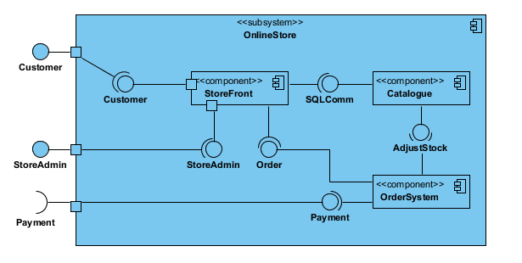
Component Diagram

Slide 21
Components as Replaceable Elements
Components allow systems to be assembled from binary replaceable elements.
• A component is bits not concepts.
• A component can be replaced by any other component(s) that conforms to the interfaces.
• A component is part of a system.
• A component provides the realization of a set of interfaces.

Slide 22
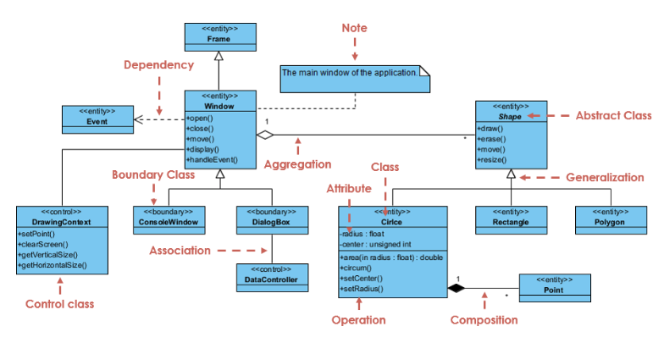
Class Diagram

Slide 23
Component Diagram vs. Class Diagram
Classes represent logical abstractions（Not covered in this lecture, will be shown in Program Design）
They have a Tributes (data) and operations (methods)
Classes can be combined to form programs (i.e., for program design)
Components have operations that are reachable only through interfaces.
Components can be combined to form systems (i.e., for system design)

Slide 24
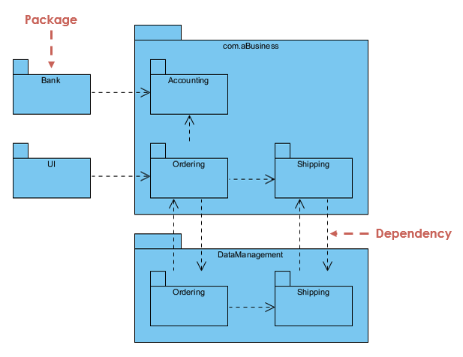
Package Diagram
A package is a general-purpose mechanism for organizing classes into packages
A package is a collection of logically related UML elements
Package Diagram can be used to simplify complex class diagrams, it can group classes into packages.
One package depends on another if changes in the other could possibly force changes in the first

Slide 25
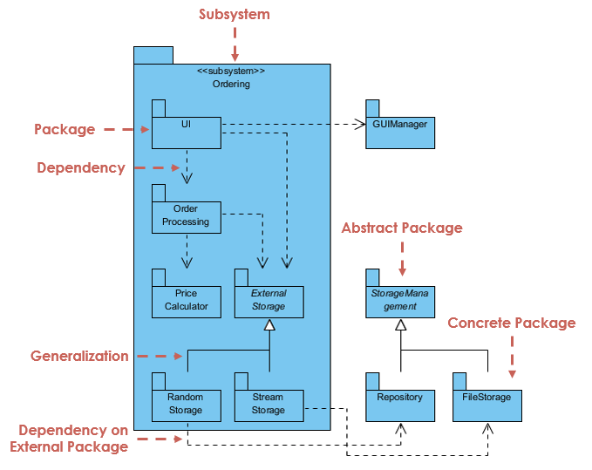
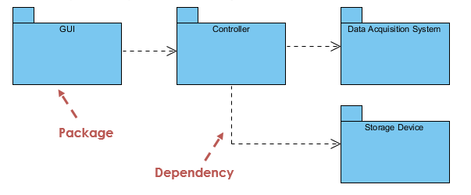
Package Diagram

Slide 26
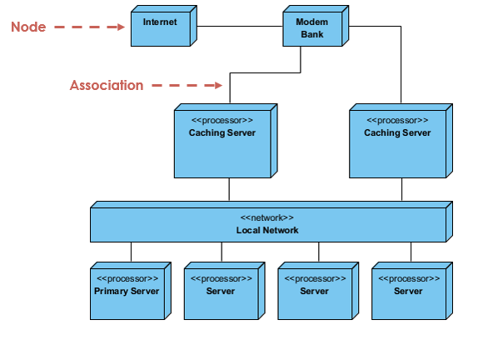
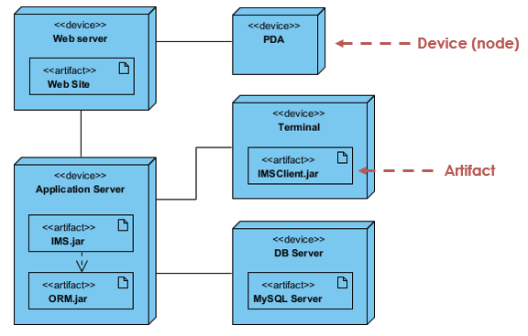
Deployment Diagram
A node is a physical element that exists at run time and provides a computational resource, e.g., a computer, a smartphone, a router.
Components may live on nodes.

Slide 27
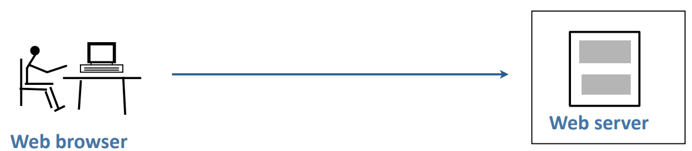
Example: Simple Web System
• Static pages from server
• All interaction requires communication with server

Slide 28
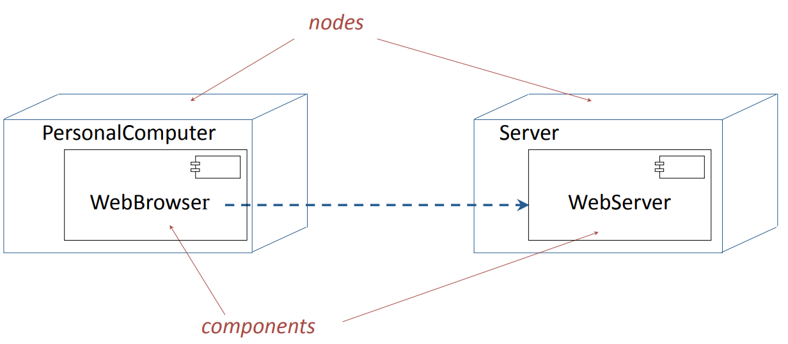
Deployment Diagram

Slide 29
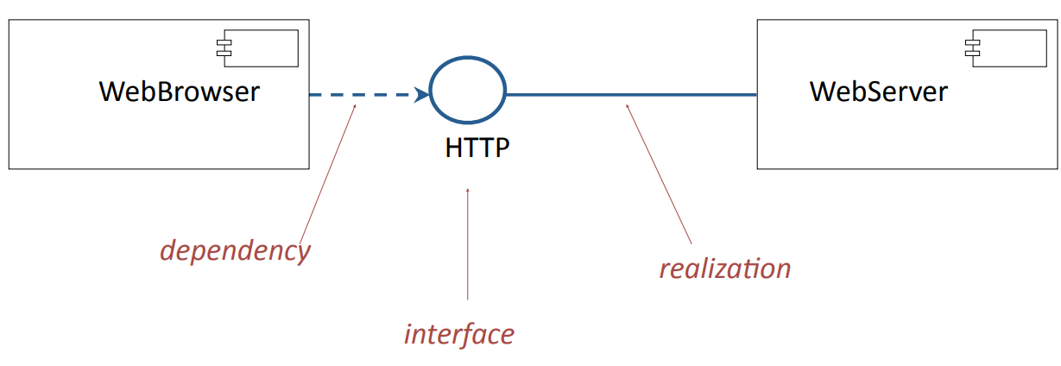
Component Diagram

Slide 30
2
PART TWO
System Design: Architectural Style

Slide 31
Architectural Styles
An architectural style is system architecture that recurs in many different applications.
See:
• Mary Shaw and David Garlan, Software architecture: perspectives on an emerging discipline. Prentice Hall, 1996
• David Garlan and Mary Shaw, An Introduction to Software Architecture. Carnegie Mellon University, 1994
http://www.cs.cmu.edu/afs/cs/project/able/ftp/intro_softarch/intro_softarch.pdf

Slide 32
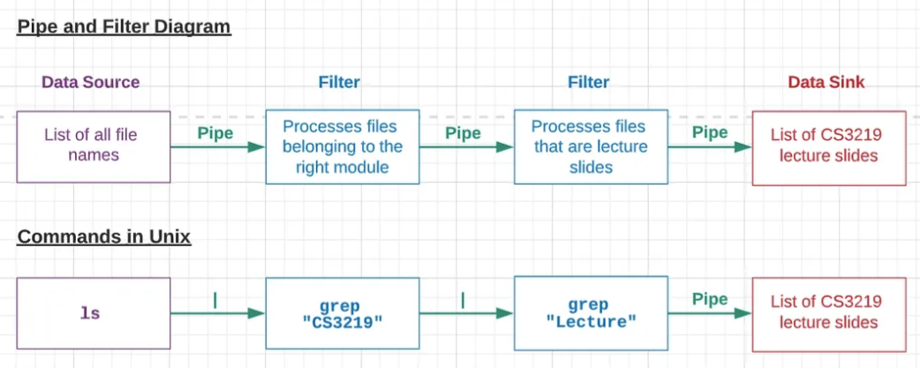
Architectural Style: Pipe&Filter
Example: Linux command line
ls | grep “CS3219” | grep “Lecture”
Output from one subsystem is the input to the next.

Slide 33
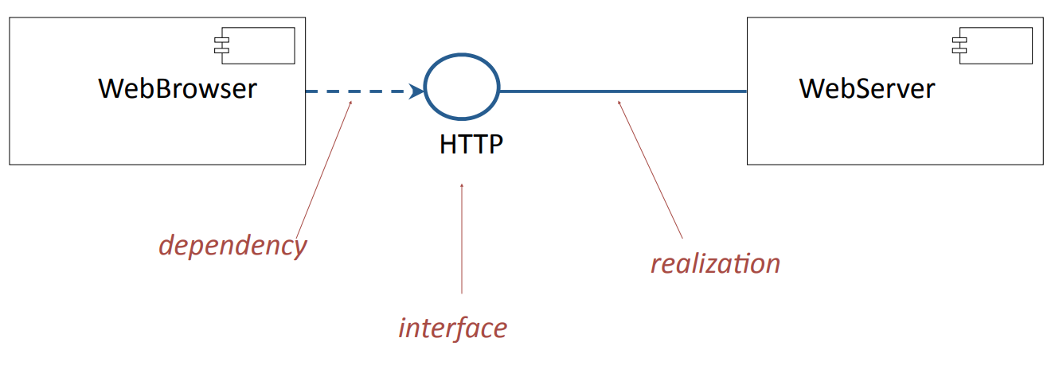
Architectural Style: Client/Server
Example: A web system
The control flows in the client and the server are independent.
Communication between client and server follows a protocol.
Because components are binary replaceable elements, either the client or the server can be replaced by another component that implements the protocol.
In a peer-to-peer architecture, the same components act as both client and server.

Slide 34
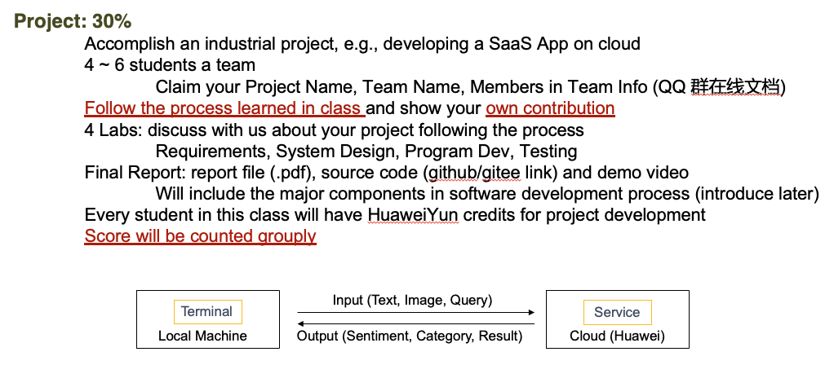
Architectural Style: Three Tier Architecture
This architecture is an extension of the client/server model
Standard architecture for small and medium sized web sites.

Slide 35
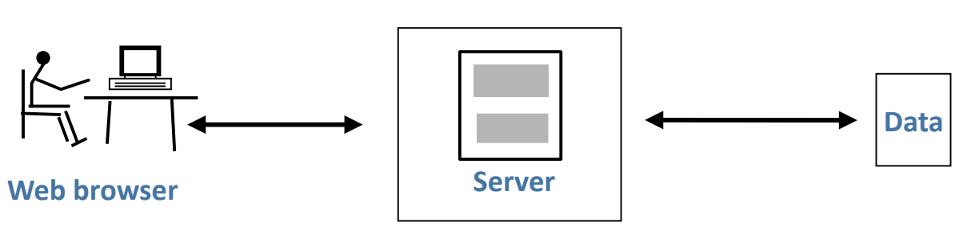
Web Server with Data Store
The basic client/server web site returns only fixed HTML pages.
Attach the server to a data store, so that it can respond to requests from the client and return suitable content
Advantage:
Server-side code can respond to user requests by accessing data, configuring pages, validating information, etc.

Slide 36
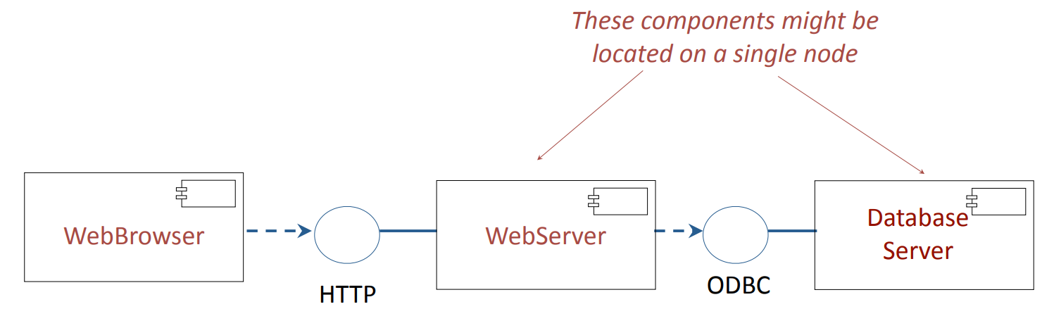
An Example
Since components are replaceable binary elements:
• Any web browser can access the web site.
• The database server can be replaced by another database that supports the same interface.

Slide 37
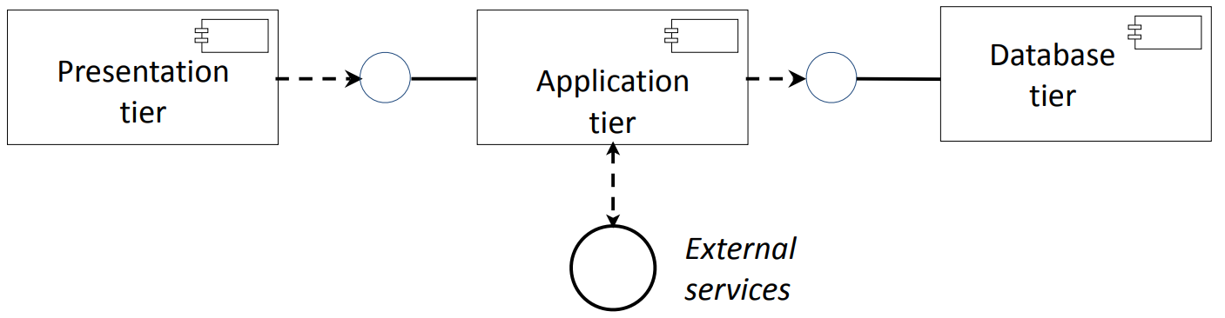
Architectural Style: Three Tier Architecture
Each of the tiers can be replaced by other components that implement the same interfaces.

Slide 38
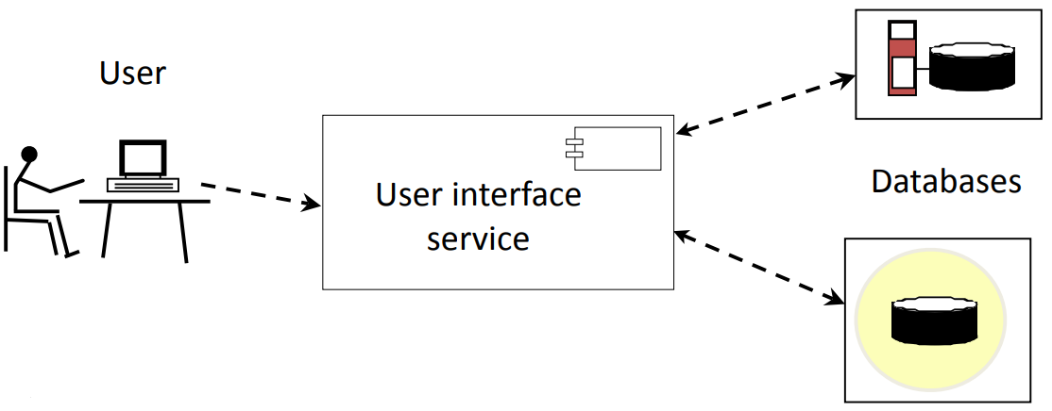
Three Tier Architecture: Broadcast Searching
This is an example of a multicast protocol.
The primary difficulty is to avoid troubles at one site degrading the entire system (e.g., every transaction cannot wait for a system to time out).

Slide 39
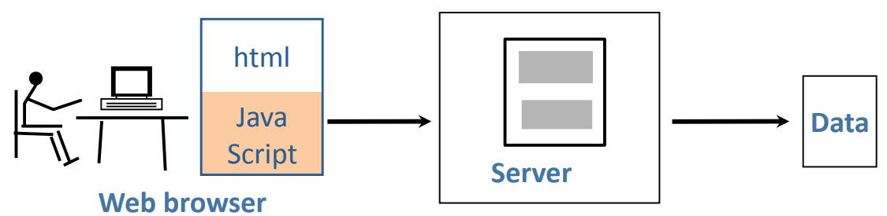
Extending the Web with Executable Code that can be Downloaded
Executable code in a scripting language such as JavaScript can be downloaded from the server.
This can be done within the three tier architecture.

Slide 40
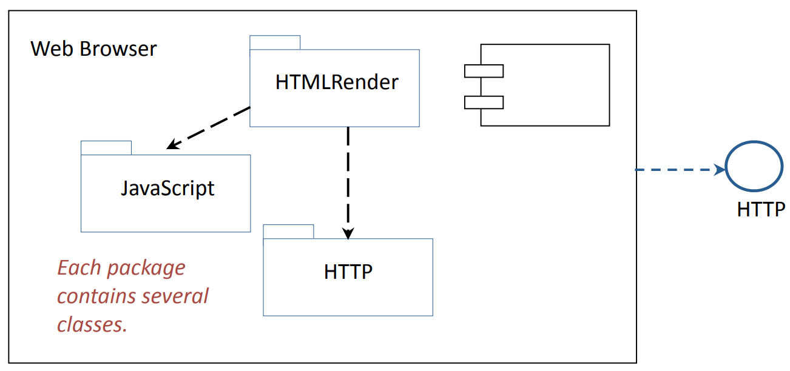
Web Browser with JavaScript
The Presentation Tier has become more complex. Since it still supports the same interface it is still a replaceable binary component.

Slide 41
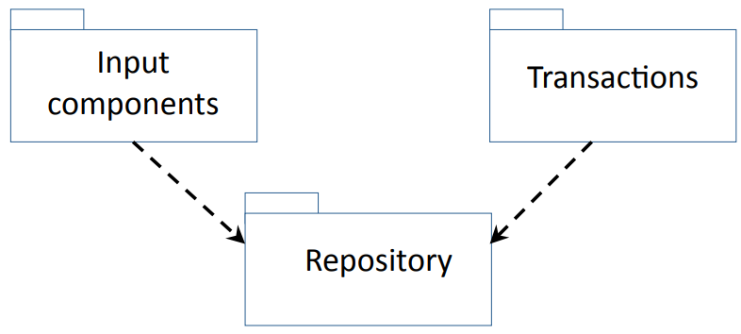
Architectural Style: Repository
Advantages: Flexible architecture for data-intensive systems.
Disadvantages: Difficult to modify repository since all other components are coupled to it.

Slide 42
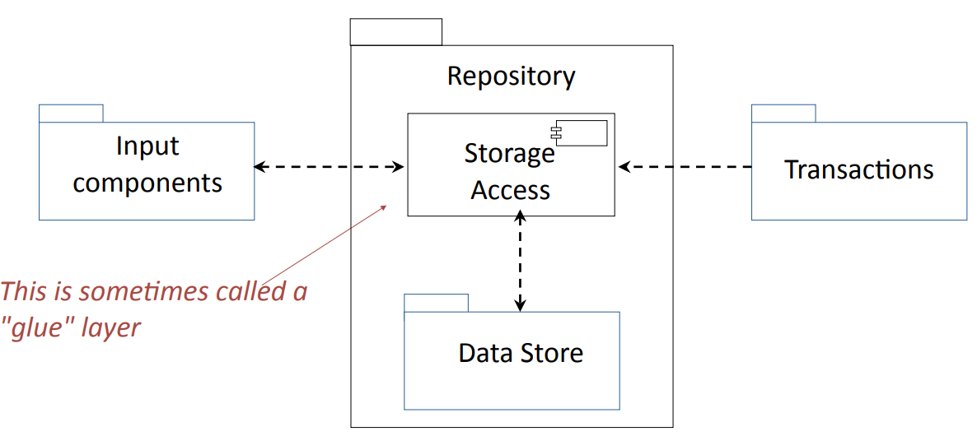
Architectural Style: Repository with Storage Access Layer
Advantages: Data Store subsystem can be changed without modifying any component except the Storage Access.

Slide 43
Architectural Styles：Batch Processing
An alternative to the repository model , widely used in data processing systems

Slide 44
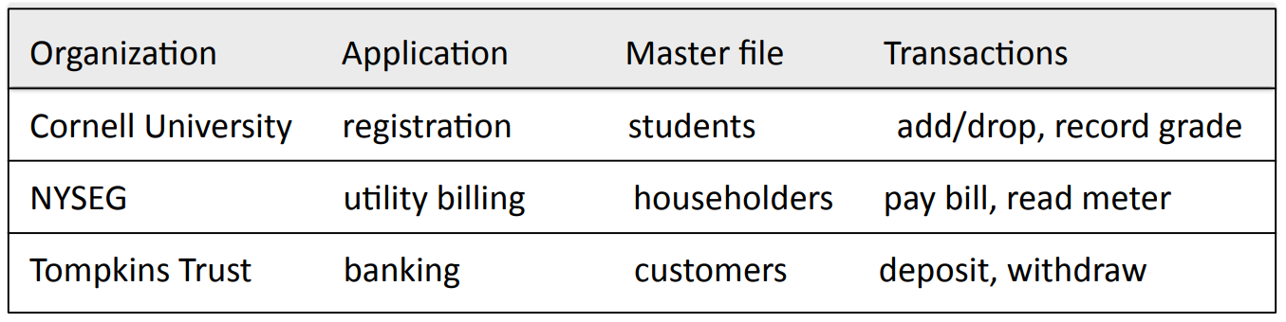
Example: Master File Update
Characteristics
• Many complex types of transaction, including reversals (corrections).
• Correctness of master file is vital to the success of the organization.
• Batch updating of master file is acceptable (e.g., overnight).
• Must be able to answer customer queries, without waiting for full update.

Slide 45
Master File Update: Transactions
Example: Electricity Utility Billing
Requirements analysis identifies many transacation types:
• Create account / close account
• Meter reading
• Payment received
• Other credits / debits
• Check cleared / check bounced
• Account query
• Correction of error
• etc., etc., etc.,

Slide 46
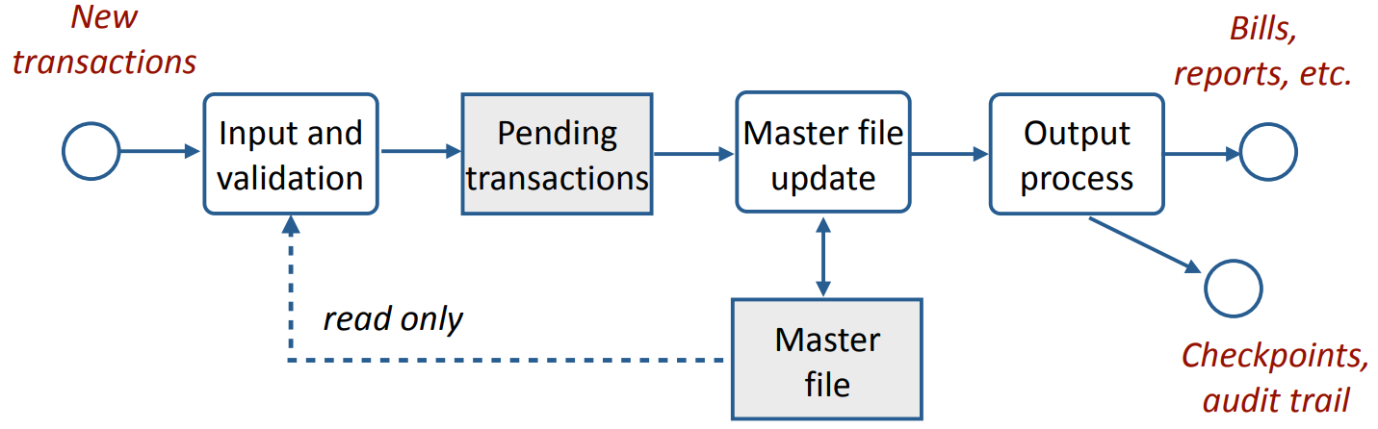
Master File with Batch Processing: Dataflow Model
• Input and validation process runs throughout the day. It processes transactions when they arrive.
• Master file update program runs once per day (usually at night).
• Output process is run after the master file update finishes.

Slide 47
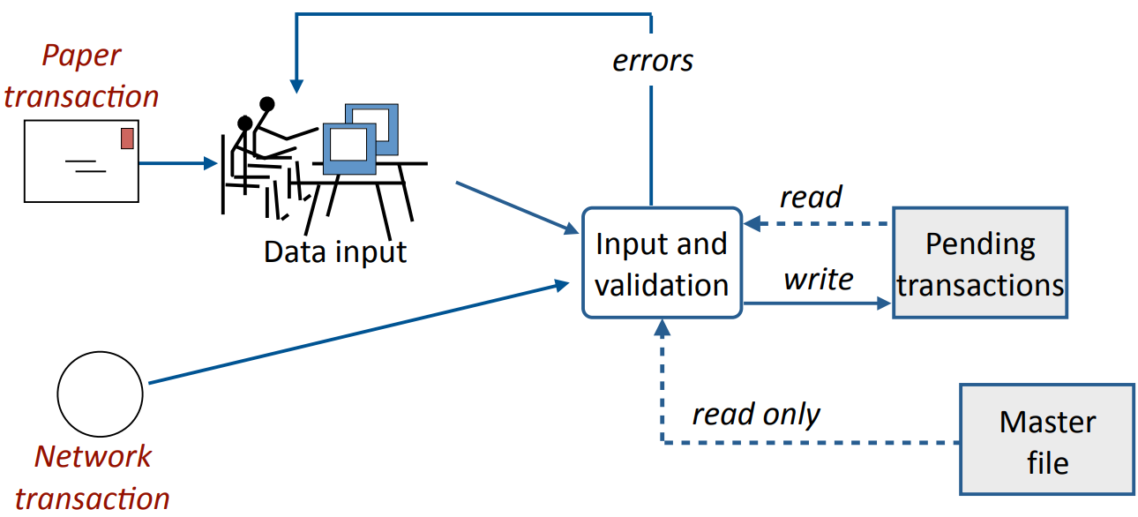
Batch Processing: Input and Validation
Because the input and validation process is able to read the master file, it can check that the transaction is compatible with the master file, e.g., file has a record for the customer.

Slide 48
Benefits of Batch Processing with Master File Update
Advantages:
• Backup and recovery have fixed checkpoints.
• Better management control of operations.
• Efficient use of staff and hardware.
• Error detection and correction is simplified.
Disadvantages:
• Information in master file is not updated immediately.
• No good way to answer customer inquiries.

Slide 49
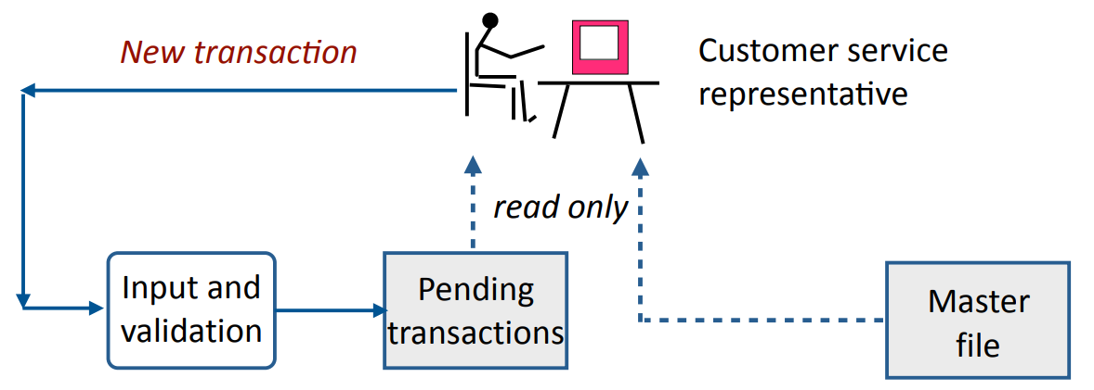
Online Inquiry
• Customer calls the organization and speaks to a customer service representative.
• The representative can read the master file and the pending file, but cannot change them.
• Optional. Customer can read selected parts of the master file and pending file without going through customer service.

Slide 50
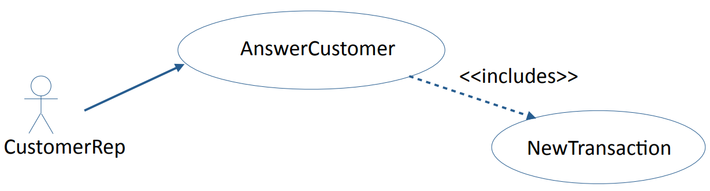
Online Inquiry: Use Case
• The representative can read the master file and pending file, but not make changes to them.
• If the representative wishes to change information in the master file, a new transaction is created and sent to the input and validation process.
• The representative can create an annotation, e.g., a note of a telephone conversation with a customer. It is treated as a new transaction.

Slide 51
Time-Critical Systems
A time-critical (real time) system is a software system whose correct functioning depends upon the results produced and the time at which they are produced.
• A hard real time system fails if the results are not produced within required time constraints,
e.g., a fly-by-wire control system for an airplane must respond within specified time limits.
• A soft real time system is degraded if the results are not produced within required time constraints,
e.g., a network router is permitted to time out or lose a packet.

Slide 52
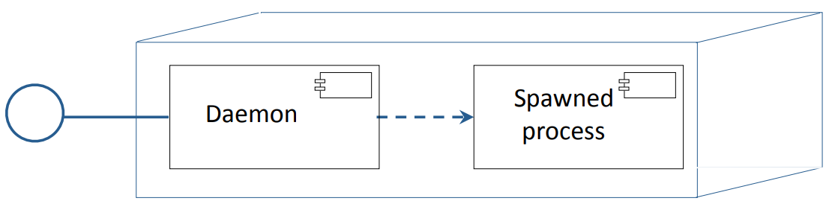
Architectural Style: Daemon
A daemon is used when messages might arrive at closer intervals than the time to process them.
Example: Web server
The daemon listens at port 80
When a message arrives it:
• spawns a processes to handle the message
• returns to listening at port 80

Slide 53
Architectural Style: MVC
Example 3: Model/View/Controller (MVC)
This architecture is used to control a complex user interface.
It is the standard architecture for mobile apps and widely used in robotics.

Slide 54
Model/View/Controller (MVC)
The definition of Model/View/Controller (MVC) is in a state of flux. The term is used to describe a range of architectures and designs.
Some are system architectures, where the model, view, and controller are separate components.
Some are program designs, with classes called model, view, and controller.

Slide 55
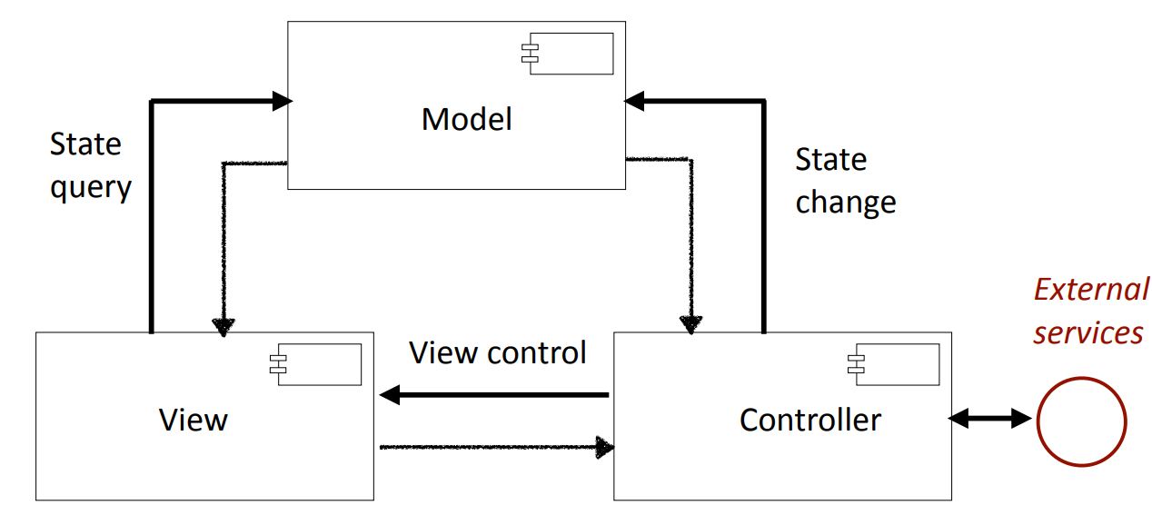
Model/View/Controller as a System Architecture

Slide 56
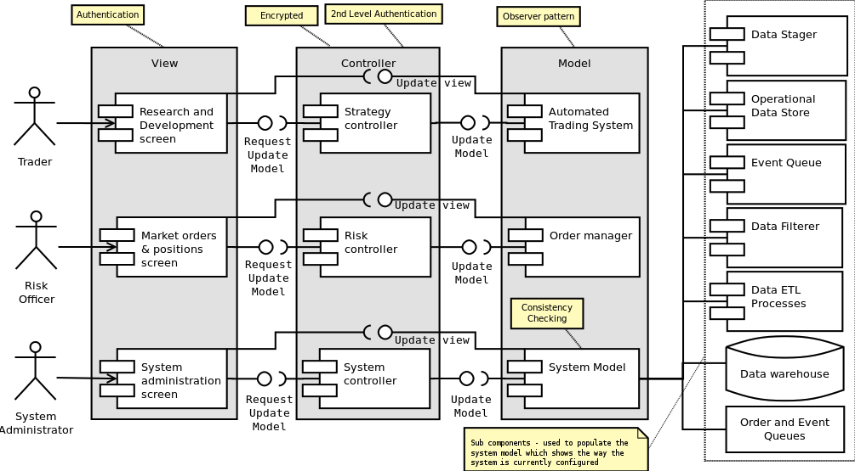
Example: Trading System

Slide 57
Discussion
A company that makes sports equipment decides to create a system for selling sports equipment online. The company already has a product database with description, marketing information, and prices of the equipment that it manufactures.
To sell equipment online the company will need to create: a customer database, and an ordering system for online customers.
The plan is to develop the system in two phases. During Phase 1,simple versions of the customer database and ordering system will be brought into production. In Phase 2, major enhancements will be made to these components.

Slide 58
Discussion
I. Draw a UML deployment diagram.

Slide 59
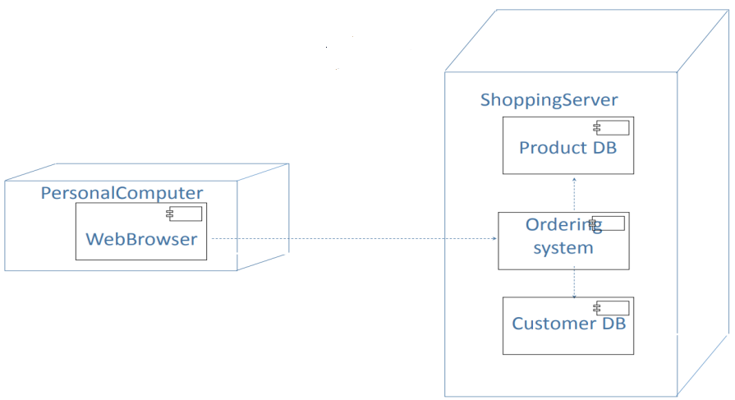
Discussion
1. Draw a UML deployment diagram.

Slide 60
Discussion
2. Draw a UML component diagram (w/ interface)

Slide 61
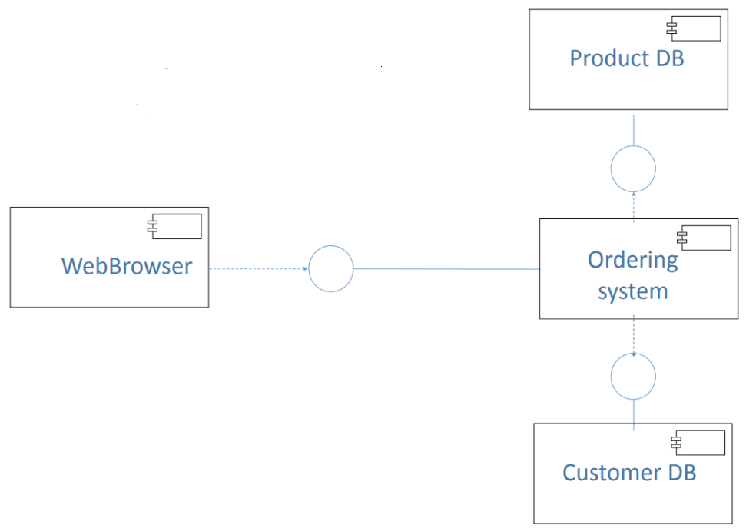
An Old Exam Question

Slide 62
Discussion
3. What architectural style would you use for the customer database?

Slide 63
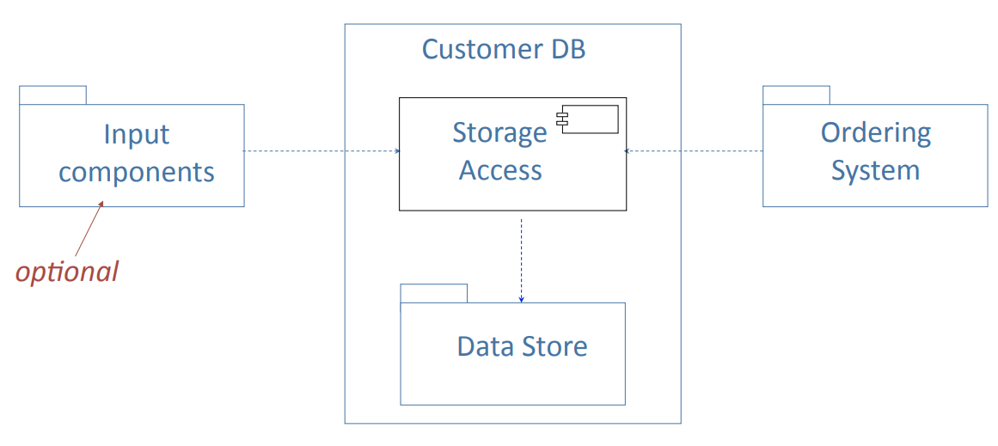
Discussion
3. What architectural style would you use for the customer database?
Repository with Storage Access Layer

Slide 64
Requirements on Final Project
9. Show the necessary system design diagram in your report

Slide 65
3
PART THREE
Virtualization

Slide 66
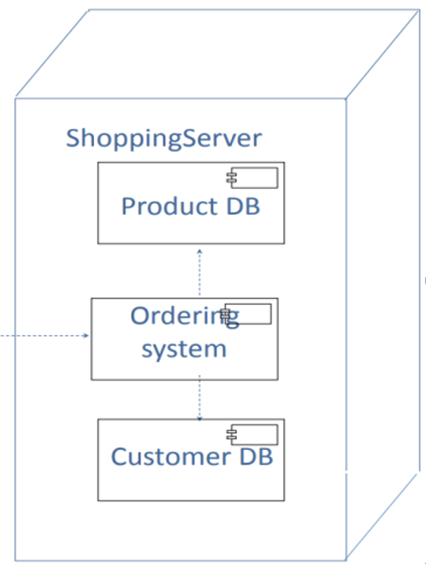
Deployment Concerns
Dependency conflicts
Configuration, data sprawl
OS portability
Unintended interactions
Filesystem has same problems as global variables
Solution: Encapsulation; but...
Deploying on separate machines risks under-utilization

Slide 67
Virtual Machines
Multiple OS instances running on one machine
Real hardware is managed by host OS or hypervisor
Improves hardware utilization, reduces cost
Avoids energy consumption by redundant hardware
Stateful – still risks data sprawl
Address with automated administration
High overhead
software redundancy
Examples: VMware, VirtualBox, Xen, Hyper-V

Slide 68
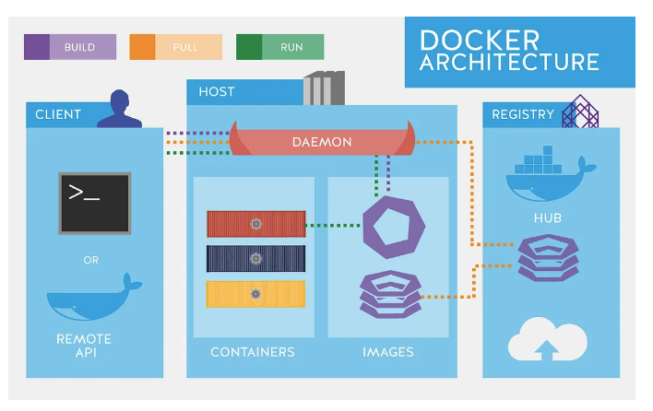
Container
Trade OS heterogeneity for reduced redundancy
Still isolate filesystem, network without duplicating OS
Lightweight – new instances start quickly
Improves elasticity
Often encapsulates a single application
Often treated as stateless
don't write to filesystem
Examples: Docker

Slide 69

Serverless
Computation nodes are stateless, ephemeral, and event-triggered
Data store services still persist state, but are application-agnostic
Application decomposed into event-handler functions
Event dispatch, container lifetime managed by platform
Examples: HuaweiCloud FunctionGraph

Slide 70

Comparison

Slide 71




Microservice
Components encapsulate services and expose them via standard interfaces (binary-replaceable)
In practice, many frameworks are language-specific
Complicated at language boundaries and distributed deployment
Microservices constrain component definition to reduce coupling
Language-agnostic protocols (e.g. RESTful HTTP)
Independently deployable
Free for Scaling

Slide 72
Thanks for your listening!
Instructor: Liu, Guangchi Ph.D.

